Slide 1
Implement SZ Compression in XIOS for Weather Forecasting Date: June 9th 2023 Presenter: Dian Hanifudin Subhi

Slide 2
Summary
Integrate SZ Compression in XIOS
Preparing Different Scenarios
Experiment Result

Slide 3
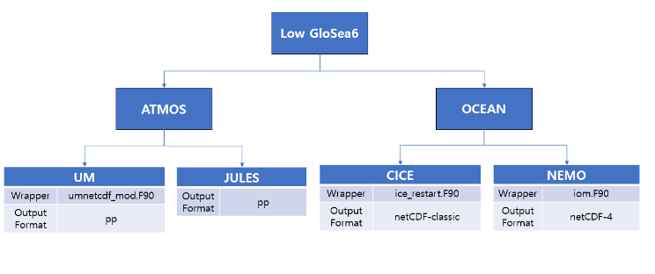
Integrate SZ Compression in XIOS
Low GloSea6 Introduction
Low GloSea6 is a community model developed by the Korea Meteorological Administration.
Low GloSea6 consists of ATMOS and OCEAN models.

Slide 4
Integrate SZ Compression in XIOS
XIOS Introduction
XIOS is a library for managing climate data I/O. The configuration is based on XML.
XIOS can be used on attached as a library or detached mode as an external executable dedicated CPUs.
XIOS project written using C++ and have ~51K LOC for header files and ~70K LOC for implementation.

Slide 5
Integrate SZ Compression in XIOS
Important files on XIOS regarding the I/O
node/file.cpp: instantiate data output object and define the logic main flow.
data_output.{cpp,hpp}: Base class regarding handling data output
io/onetcdf4.{cpp,hpp}: Responsibility for general output of netCDF capability (open, close, definition and initialize)
io/nc4_data_output.{cpp,hpp}: Responsible for writing the variable, attribute, and also dimension.
io/netCdfInterface.cpp: C++ wrapper of netCDF C API function

Slide 6
Integrate SZ Compression in XIOS
SZ Introduction
SZ is lossless compression that offer high compression ratio supported C and Fortran API.
SZ using sz.config file to configure the compression such as errorBoundMode, absErrBound, relBoundRatio etc.

Slide 7
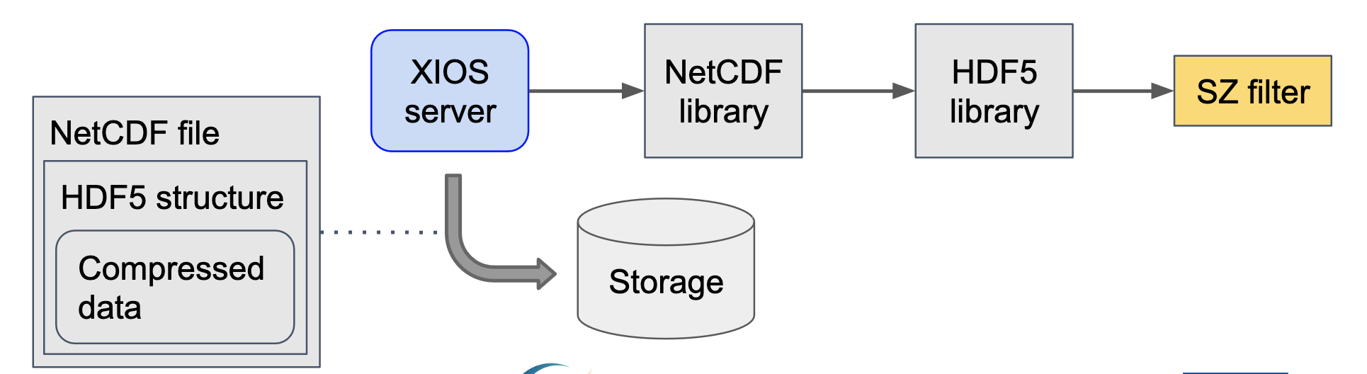
Integrate SZ Compression in XIOS
Proposed Integration
The climate data uses NetCDF format to store the model.
The H5Z-SZ filter support to apply SZ compression for NetCDF4 format
The approach to implement SZ compression as shown below figure

Slide 8
Preparing Different Scenarios
VCS Branching
The different scenarios and configurations are needed to perform different scenarios evaluation
The Low GloSea6 codebase is managed using subversion + FCM and the XIOS codebase is managed using git
The VCS supports creating branches to help develop and incubate features. This feature can help to have different scenarios without comment/uncomment code.

Slide 9
Preparing Different Scenarios
Examples
Applied different branches for scenarios:
Nocompress: branches/dev/changwon
gzip: branches/dev/hongik
Other examples:
main: stable branch at production
develop: pre-production code
feature/x-feature: development of new feature

Slide 10
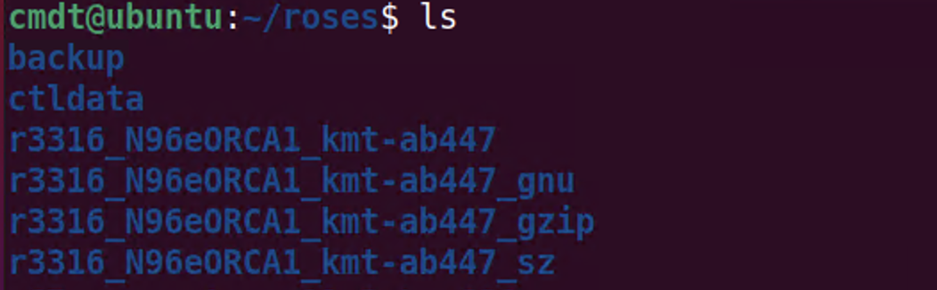
Experiment Results
Run Scenario
Scenario
nocompress: r3316_N96eORCA1_kmt-ab447_gnu
gzip: r3316_N96eORCA1_kmt-ab447_gzip

Slide 11
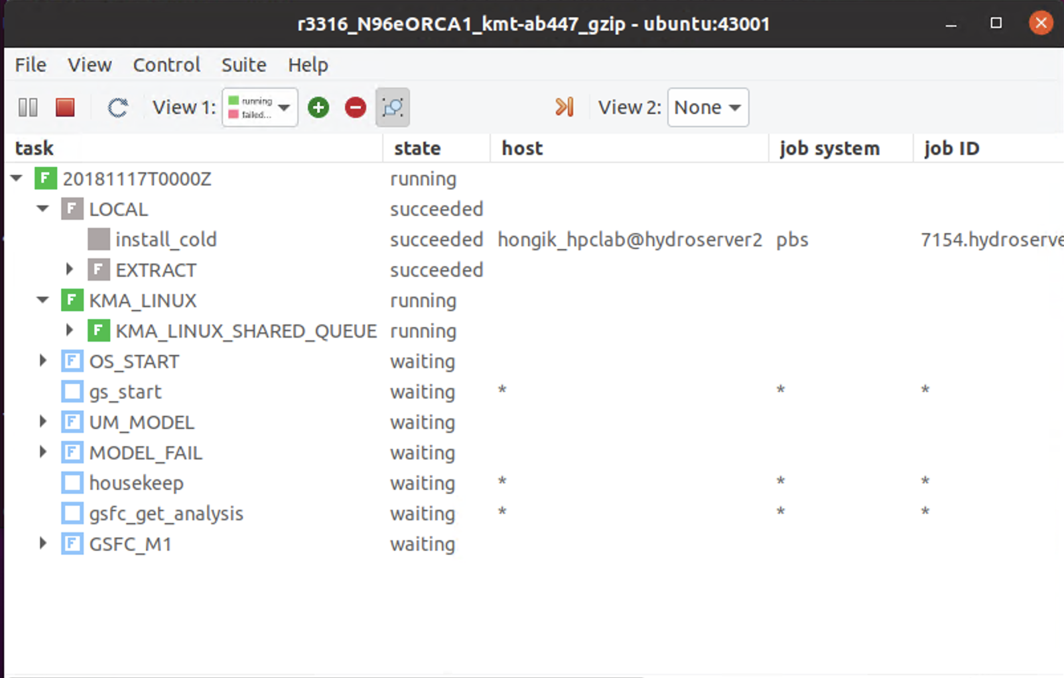
Experiment Results
Run Scenario

Slide 12
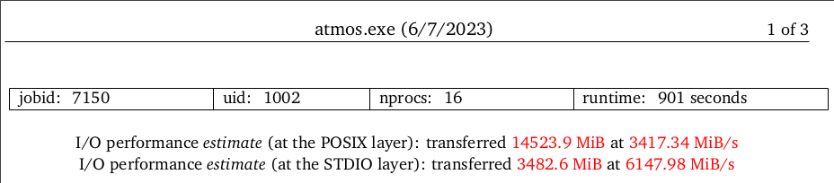
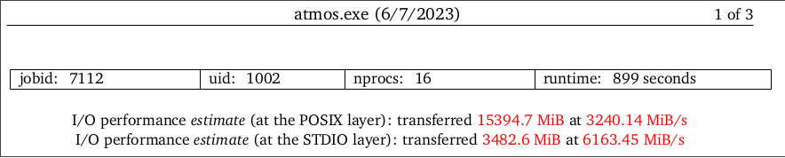
Experiment Results
Current comparison result regarding enabled compression
Enable default compression can improve I/O performance by ~6% for the current evaluation profiled by Darshan as shown in the figure below.

Slide 13
Conclusion/Your thoughts
The XIOS default gzip compression has been enabled from Low GloSea6 and can improve the I/O performance
The H5Z-SZ filter needs to be tested for SZ compression integration in XIOS.

Slide 14
Action items
Implementing SZ compression in XIOS used the H5Z-SZ filter from NetCDF API calls.
Modified XIOS to perform SZ compression by utilizing

